Slide 2
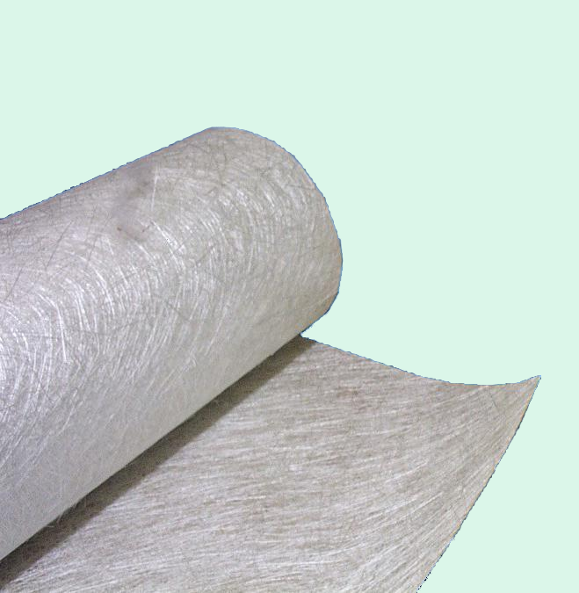
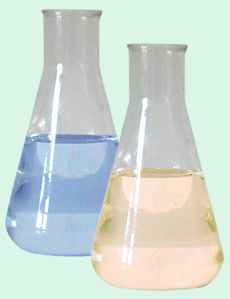
Composite Materials
DEFINITION:
A material composed of 2 or more constituents
i. Reinforcement phase (i.e., Fibres)
ii. Binder phase (i.e., compliant matrix)
Glass Matt Reinforcement
Resin
Notes:
2

Slide 3
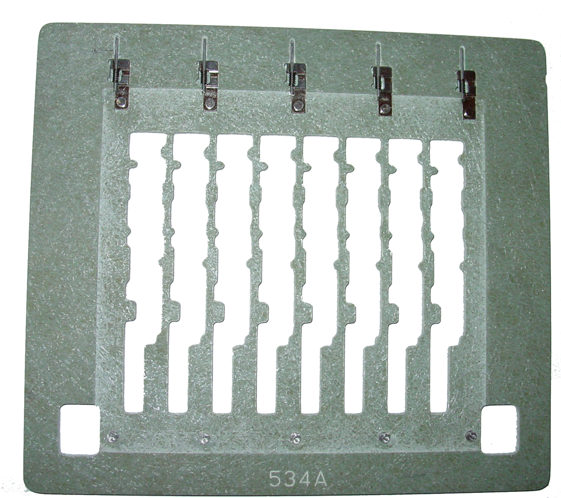
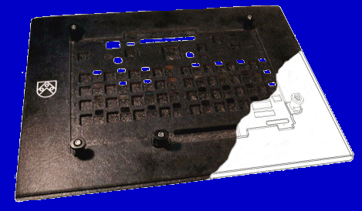
APPLICATIONS OF COMPOSITE MATERIALS
Composite materials can be used for the following applications in the PCB assembly process.
Solder Paste Printing
SMT Placement
Reflow owen process
Wave and selective soldering
Conformal Coating
SMT Pallets
Wave Solder pallets

Slide 4
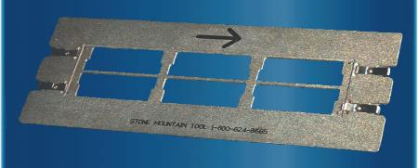
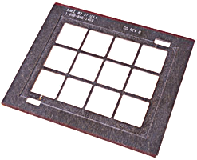
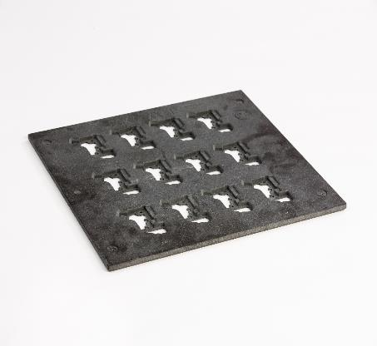
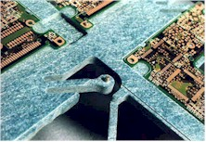
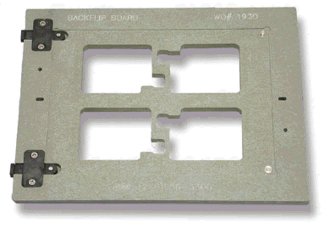
SMT ASSEMBLY PALLETS
Notes:
4

Slide 5
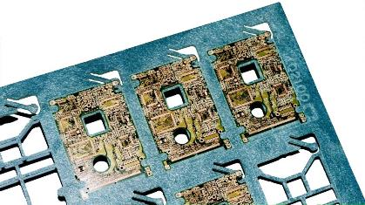
Composite materials are the ideal choice for the SMT assembly process due
to the following factors,
Low thermal conductivity reducing the heat-sinking effect from the PCB.
Good flatness and thickness tolerances.
Dimensional stability at elevated temperatures.
Accurate tolerances can be achieved.
Applications include the printing placement and reflow of,
Thin or flexible PCBs
Odd shaped PCBs
Panelising small individual PCBs

Slide 6
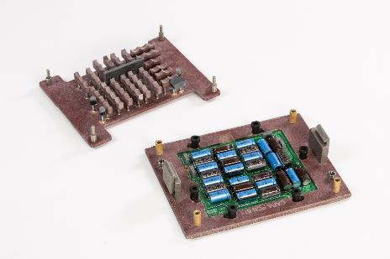
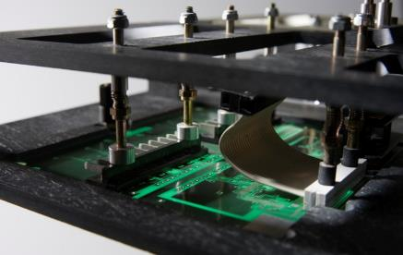
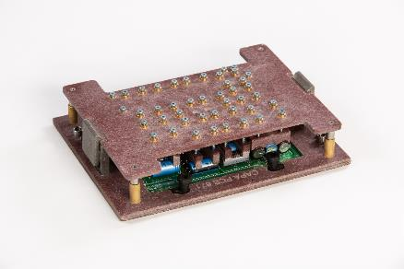
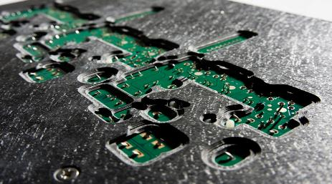
Wave Solder Pallets
Page 6

Slide 7
Wave Soldering Process
In the wave soldering process, composite materials can
improve the efficiency of the process by,
Eliminating the need for hand masking.
Masking bottom side SMT components,
enabling selective soldering.
Preventing bowing of the PCB.
Standardising production line widths.
Increasing throughput using multi-aperture fixtures.
Reducing rework and scrap.

Slide 8
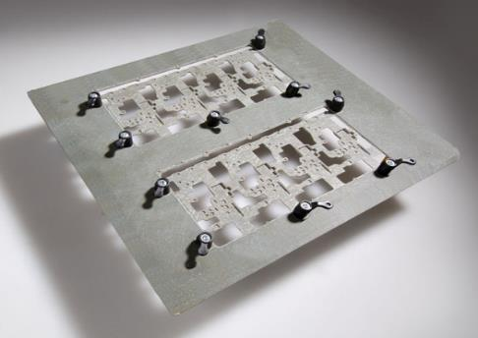
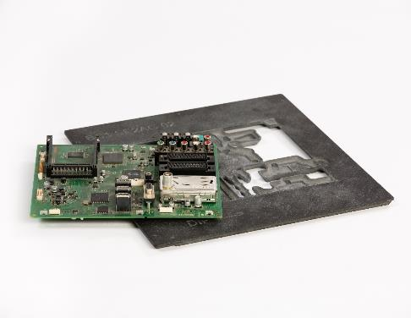
Wave Soldering Process
The main application today
is selective soldering.
Composites have enabled
PCB assembly companies
to produce products on
standard equipment that
would have otherwise been
produced by hand or on
custom machinery.

Slide 9
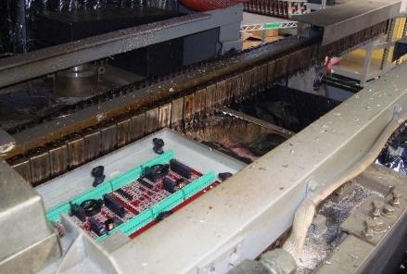
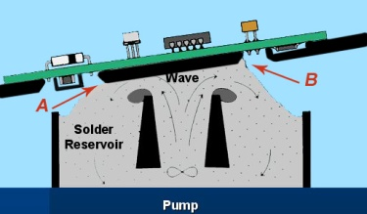
Wave Solder Process

Slide 10
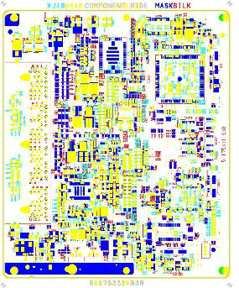
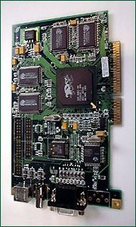
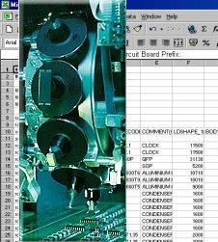
Wave Solder Pallet Design Requirements
To provide a well designed, effective selective solder pallet, as much information as possible must be supplied by the end user.
Gerber File
Populated PCB
X-Y Placement and Component Height Data

Slide 11
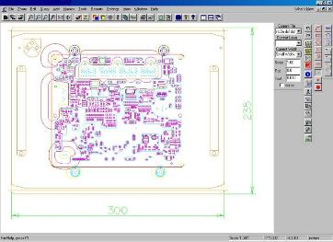

Selective Solder Pallet Manufacture
SOLDER PALLET DESIGN
CNC MACHINING CENTRE

Slide 12
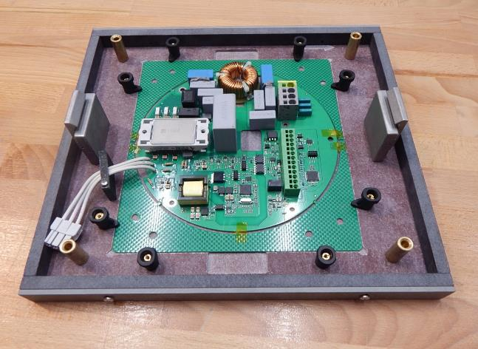
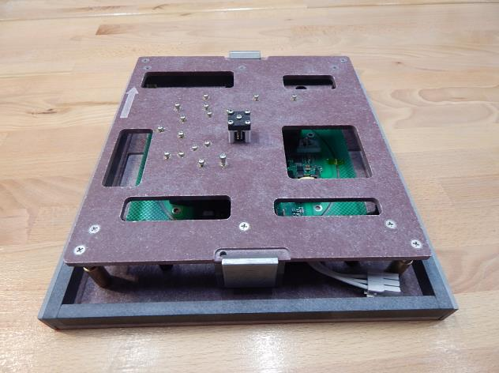
Labara implemented projects:
Project no.1:Project for wave soldering, agresive flux (raw materiál CFR767
Notes:
12

Slide 13
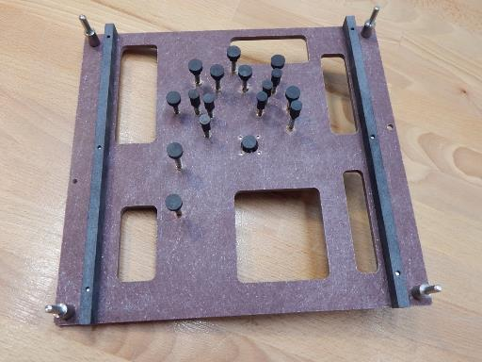
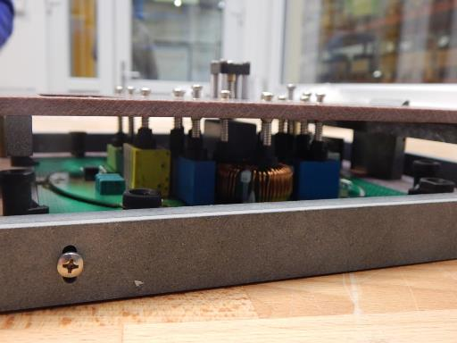
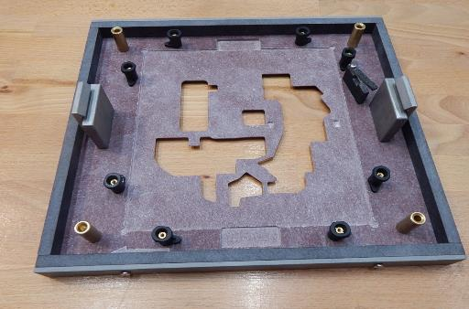
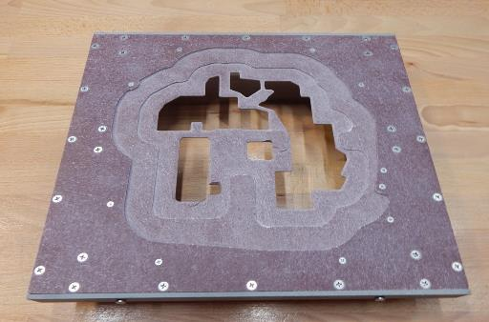

Slide 14
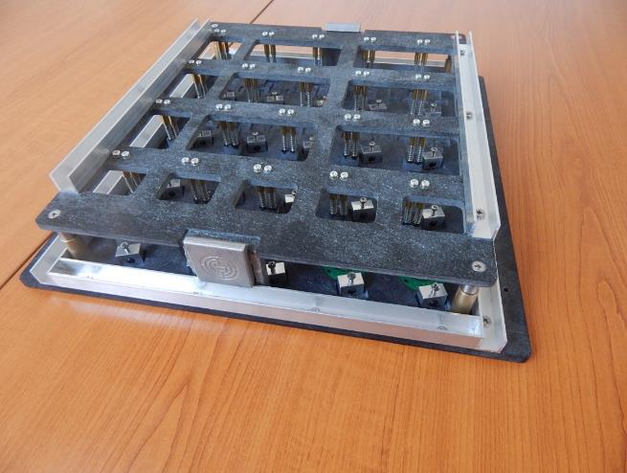
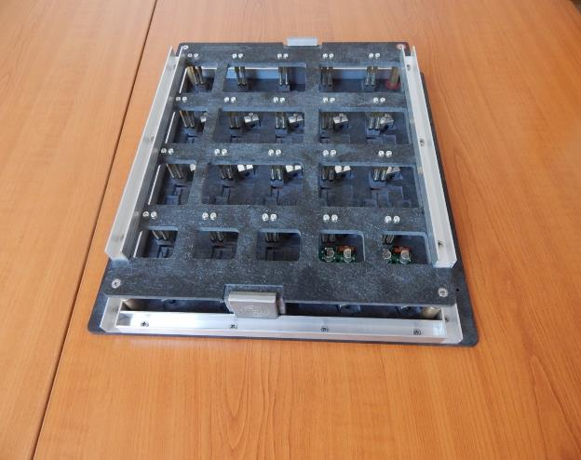
Project no. 2
Project for wave soldering, accurate solder of pins. Material CAS761: Good mechanical resistance of raw materiál

Slide 15
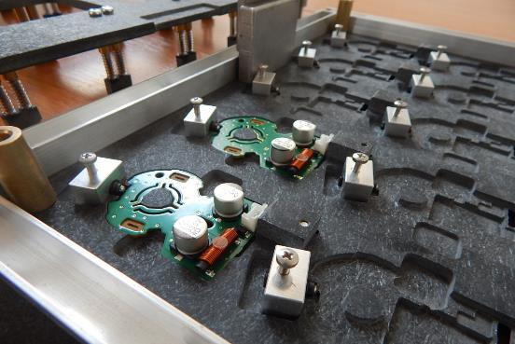
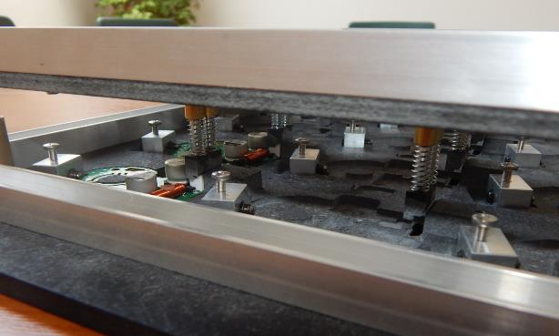
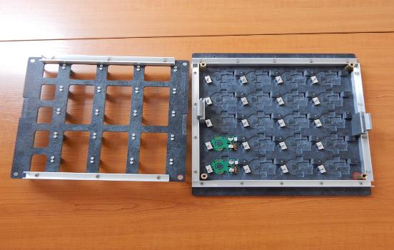
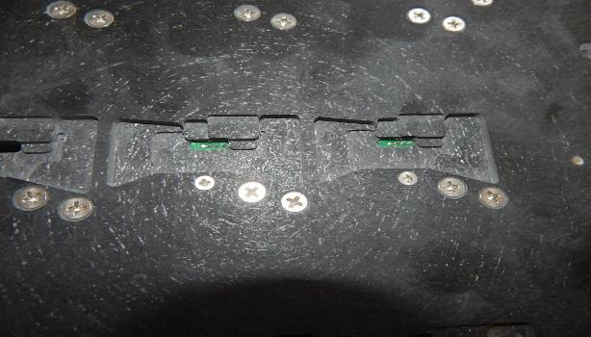

Slide 16
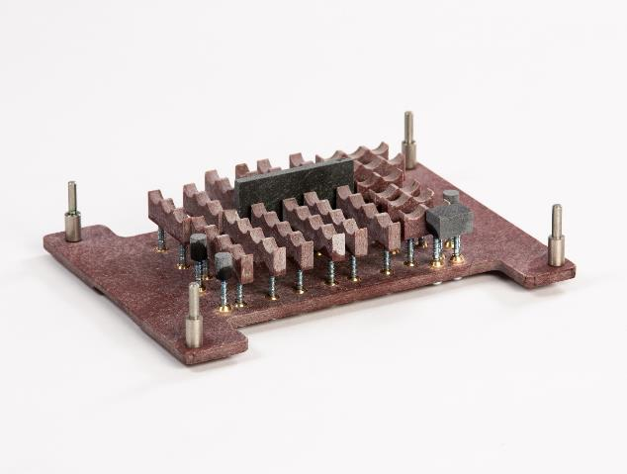
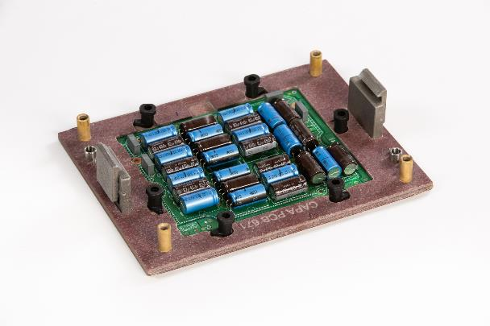
Project no. 3
Automotive company. CFR767 used to resist agresive fluxes.
Wave soldering of PCB for car radios and car navigation panel systems
Notes:
16

Slide 17
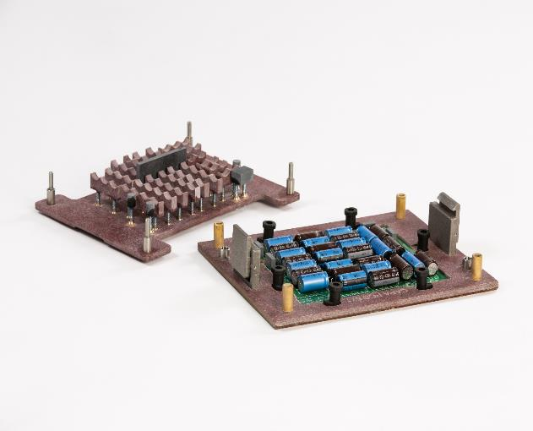
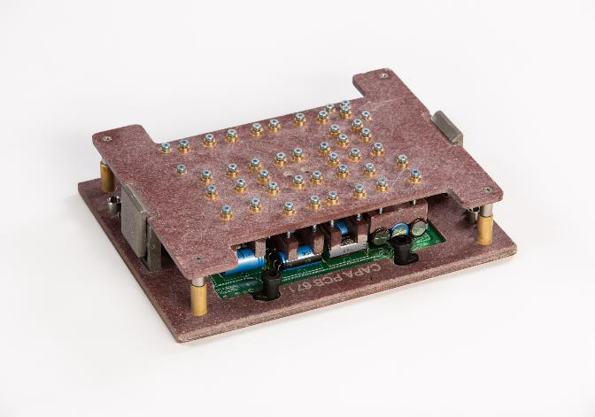
Project no. 3

Slide 18
Thank you for your attention. Following LABARA contacts:
Product responsible person:
Robert Konecny
Labara s.r.o, Jindrichov 20
595 01 Velka Bites
Czech Republic
Tel: 00420 566 531 691
Mobil: 00420 721 833 511
Email: konecny@labara.cz
Hungarian market resp. Contact:
Katarina Kekesiova:
Tel: 00421 911 846 424
Email: kekesiova@labara.cz
vydani: 02/2020
Notes:
18

